Slide 1
Inheritance

Slide 2
A Tale of Two Objects
Ship
position velocity num_torps
move attack
Class
Variables/ properties
Methods

Slide 3
A Tale of Two Objects
Ship
position velocity num_torps
move attack
Torpedo
position velocity
move attack
What do you notice about the two objects?

Slide 4
Inheritance
Mobile Object
position velocity
move attack
is-a
is-a
Ship
num_torps
attack
Torpedo
explode

Slide 5
Inheritance
Exploit commonality to share structure and behaviour

Slide 6
Inheritance
Objects that exhibit similar functionality should “inherit” from the same base object, called the superclass.
An object that inherits from another is called the subclass.

Slide 7
Subclasses
A class can extend the definition of another class
Allows use (or extension ) of methods and attributes already defined in the previous one.
New class: subclass. Original: parent, ancestor or superclass
To define a subclass, put the name of the superclass in parentheses after the subclass’s name on the first line of the definition. class cs_student(student):

Slide 8
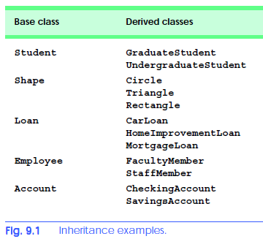
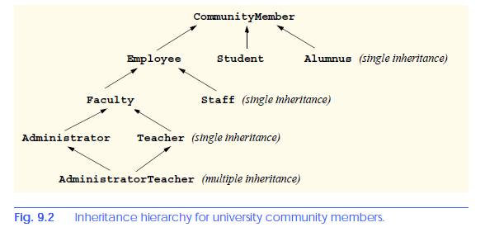
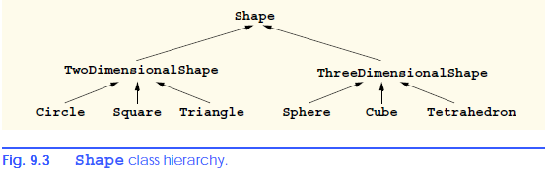
Examples of Inheritance

Slide 9
Redefining Methods - Overriding
To redefine a method of the parent class, include a new definition using the same name in the subclass.
The old code won’t get executed.
To execute the method in the parent class in addition to new code for some method, explicitly call the parent’s version of the method.
parentClass.methodName(self, a, b, c)
The only time you ever explicitly pass ‘self’ as an argument is when calling a method of an ancestor.

Slide 10
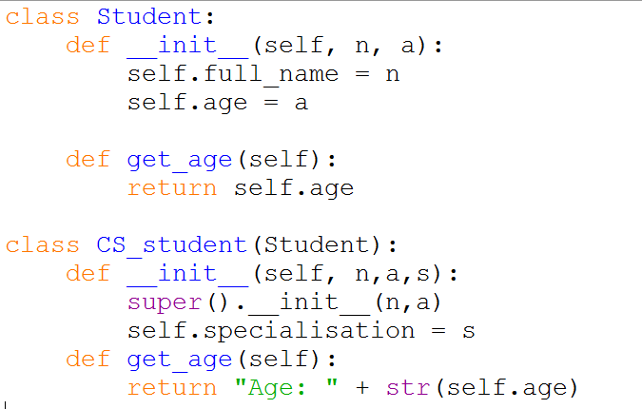
Definition of a class extending student

Slide 11
Extending __init__
Same as for redefining any other method…
Commonly, the ancestor’s __init__ method is executed in addition to new commands.
You’ll often see something like this in the __init__ method of subclasses:
super().__init__(x, y) where super() refers to the parent’s class.
Alternatively, you can write
Student.__init__(self,n, a)

Slide 12
isinstance vs type
class Vehicle:
...
class Truck(Vehicle):
...
isinstance(Vehicle(), Vehicle) # returns True
type(Vehicle()) == Vehicle # returns True
isinstance(Truck(), Vehicle) # returns True
type(Truck()) == Vehicle # returns False
type(Truck()) == Truck # returns True

Slide 13
Another Example: A Speaker
class Speaker(object):
def say(self,stuff):
print(stuff)
What does the speaker do?

Slide 14
Example: A Speaker in action
>>> ah_beng = Speaker()
>>> ah_beng.say(“Hello World”)
Hello World
>>> ah_beng.dance()
Traceback (most recent call last):
File "<stdin>", line 1, in <module>
AttributeError: 'Speaker' object has no attribute 'dance'

Slide 15
More about Inheritance
We can define an object type to be a more “specialized” kind of some other object type
Example:
A lecturer is a kind of speaker
The lecturer also has a method called lecture
To lecture something, the lecturer says it and then says: “You should be taking notes”

Slide 16
More about Inheritance
Observations:
A lecturer can do anything a speaker can (i.e. say things), and also lecture
Lecturer inherits the “say” method from speaker
Lecturer is a subclass of speaker
Speaker is a superclass of lecturer

Slide 17
Making a Lecturer
class Lecturer(Speaker):
def lecture(self, stuff):
self.say(stuff)
self.say("You should be taking notes”)
Python would go through up in the class hierarchy if a method definition is not found in the class

Slide 18
Example: A Lecturer in action
>>> jordan = Lecturer()
>>> jordan.lecture(“Java is easy”)
Java is easy
You should be taking notes
>>> jordan.say(“You have a quiz today”)
You have a quiz today

Slide 19
Making an Arrogant Lecturer
Define an arrogant lecturer to be a kind of lecturer
Whenever an arrogant lecturer says anything, she or he will say it as an ordinary lecturer would, but he will also add some favourite phrase of his/hers at the end.

Slide 20
Making an Arrogant Lecturer
class ArrogantLecturer(Lecturer):
def __init__(self, favourite_phrase):
self.favourite_phrase = favourite_phrase
def say(self, stuff):
super().say(stuff + self.favourite_phrase)
super() allows us to access methods in the superclass.

Slide 21
Example: An Arrogant Lecturer in action
>>> lorraine = ArrogantLecturer(“ ... How cool is that?”)
>>> lorraine.say(“We’d have a re-midterm tomorrow”)
We’d have a re-midterm tomorrow ... How cool is that?
>>> lorraine.lecture(“Python is cool”)
Python is cool ... How cool is that?
You should be taking notes ... How cool is that?

Slide 22
Polymorphism
Object-oriented programming provides a convenient means for handling polymorphic functions (overloading)
Functions that take different types of arguments
The same message can be sent to different types of objects and handled by different methods that perform the proper actions based on the object class (overriding)
e.g. ask a speaker, lecturer, or arrogant-lecturer to “say” something
How would you implement overloading?

Slide 23
Polymorphism
Benefits for programmer:
does not need to worry about the type of the object
can focus on the message

Slide 24
Multiple Inheritance
A class can inherit from multiple classes
C is subclass of both A and B
A class inherits both its state and methods from superclasses
C has methods: foo, bar, yum
Multiple inheritance has issues:
Not all languages support this
Resolution order issues
A
foo
B
bar
is-a
is-a
C
yum

Slide 25
Multiple Inheritance
class Singer(object):
def say(self, stuff):
print("tra-la-la -- " + stuff)
def sing(self):
print("tra-la-la")
What does the singer do?

Slide 26
Multiple Inheritance
class Singer(object):
def say(self, stuff):
print("tra-la-la -- " + stuff)
def sing(self):
print("tra-la-la")
What is the singer a subclass of?

Slide 27
Moonlighting.... shhhhh
Suppose Lorraine decides to moonlight as a singer....
class SingingArrogantLecturer(ArrogantLecturer, Singer):
def __init__(self, favourite_phrase):
super().__init__(favourite_phrase)
Note the order of the super class!

Slide 28
Lorraine showing off her hidden talents
>>> lorraine = SingingArrogantLecturer(“ ... How cool is that?”)
>>> lorraine.say(“We’d have a re-test1 tomorrow”)
We'd have a re-test1 tomorrow ... How cool is that?

Slide 29
Lorraine showing off her hidden talents
>>> lorraine.lecture(“Python is cool”)
Python is cool ... How cool is that?
You should be taking notes ... How cool is that?
>>> lorraine.sing()
tra-la-la

Slide 30
Multiple Inheritance
Complication arises when the same method is available in two distinct superclasses
Lorraine is both a singer and a lecturer, but primarily a lecturer
If her internal arrogant lecturer has a method with the name given by the message, then that method is returned
If the singer has no method with that name, then the message is passed to the internal singer.

Slide 31
Benefits of OOP
Simplification of complex, possibly hierarchical structures
Easy reuse of code
Easy code modifiability
Intuitive methods
Hiding of details through message passing and polymorphism

Slide 32
Costs of OOP
Overhead associated with the creation of classes, methods and instances

Slide 33
Major Programming Paradigms
Imperative Programming
C, Pascal, Algol, Basic, Fortran
Functional Programming
Scheme, ML, Haskell,
Logic Programming
Prolog, CLP
Object-oriented programming
Java, C++, Smalltalk
Python??

